Slide 1
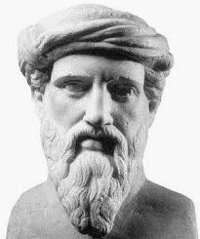
The father of Mathematics
570 BC – 496 BC
His life, work and influence
«Πάντα τὰ ὄντα ἀριθμοὶ καὶ ἐξ ἀριθμῶν»

Slide 2
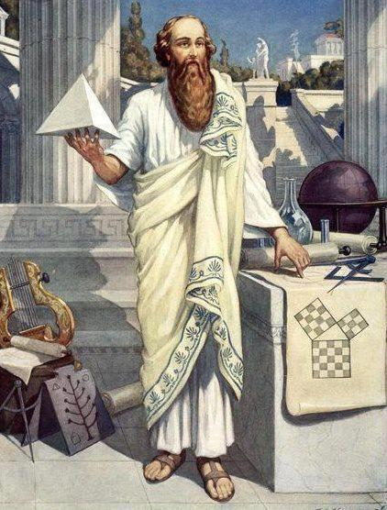
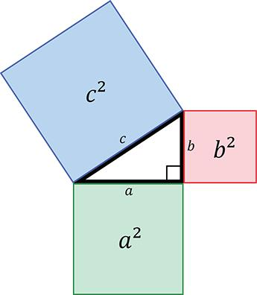
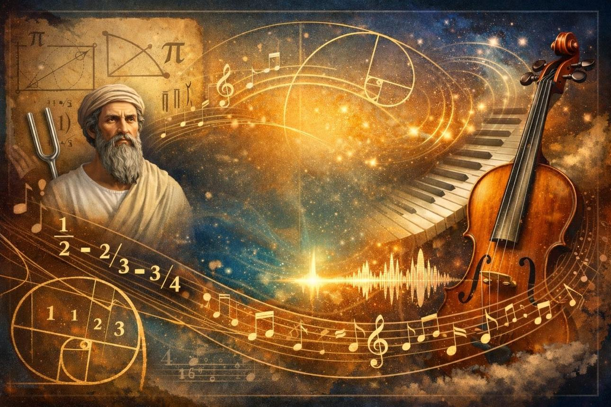
Pythagoras was one of the most important philosophers and mathematicians of ancient Greece.
His name is mainly associated with the Pythagorean Theorem, but his contribution was not limited to mathematics.
He deeply influenced philosophy, music, science, and the way people understand the world.

Slide 3





The Life of Pythagoras
The Pythagorean School
“Everything is Number”
The Pythagorean Theorem
Music and Mathematics
The End of Pythagoras
The Influence of Pythagoras
1
2
3
4
5
6
7
7
ℝ
α²+b²=c²

Slide 4
The End of Pythagoras
Music and Mathematics
The Life of Pythagoras
«Everything is Number»
The Pythagorean School
The Pythagorean Theorem
The Influence of Pythagoras
6
7
5
1
2
3
4
7
by Akis Mouchtaroglou
α²+b²=c²

Slide 5
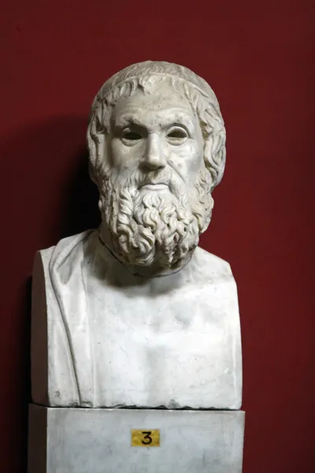




The Life of Pythagoras
Pythagoras was born around 570 BC on the island of Samos, a Greek island in the eastern Aegean Sea. Little is known about his early life because he left no written works, and most information comes from later writers.
ℝ
a²+b²=c²

Slide 6
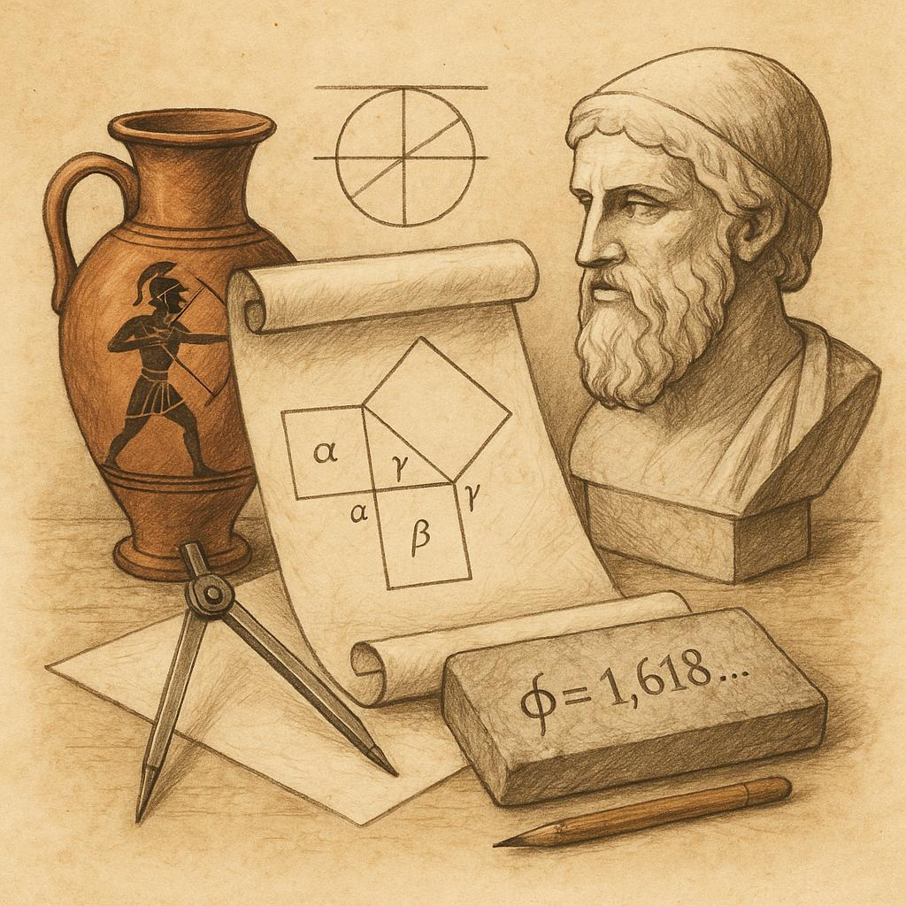
From a young age, he showed great interest in knowledge, philosophy, and mathematics. According to historical sources, he traveled to different parts of the known world, such as:
Egypt,
Babylon,
and possibly India
ℝ
α²+b²=c²

Slide 7
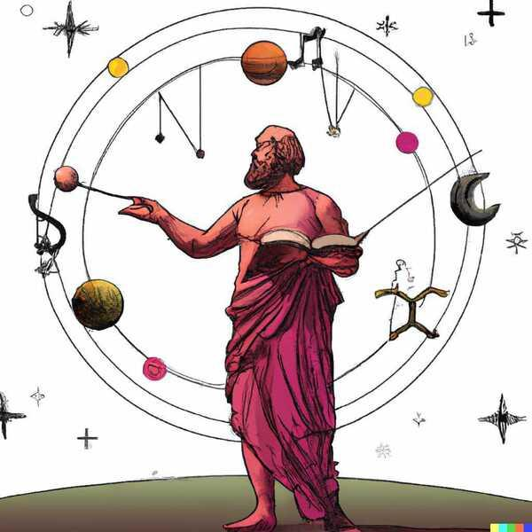
There he came into contact with different cultures and gained knowledge about mathematics, astronomy, and religion.
Later, he settled in Croton, in Magna Graecia in southern Italy, where he founded the famous Pythagorean School.
ℝ
α²+b²=c²

Slide 8
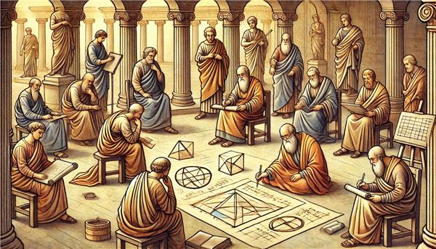
The Pythagorean School
The Pythagorean School was not simply a mathematics school.
It was an organized philosophical and religious community with strict rules.
ℝ
α²+b²=c²

Slide 9
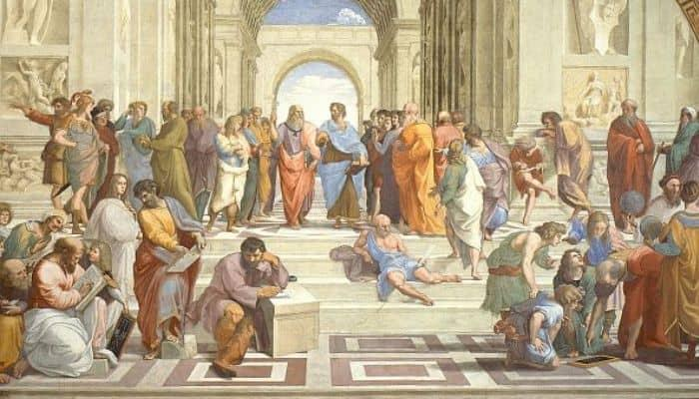
The students of Pythagoras lived together and followed a specific way of life. They believed in discipline, self-control, and harmony. In many cases, they followed a vegetarian diet and considered silence and meditation very important.
ℝ
α²+b²=c²

Slide 10
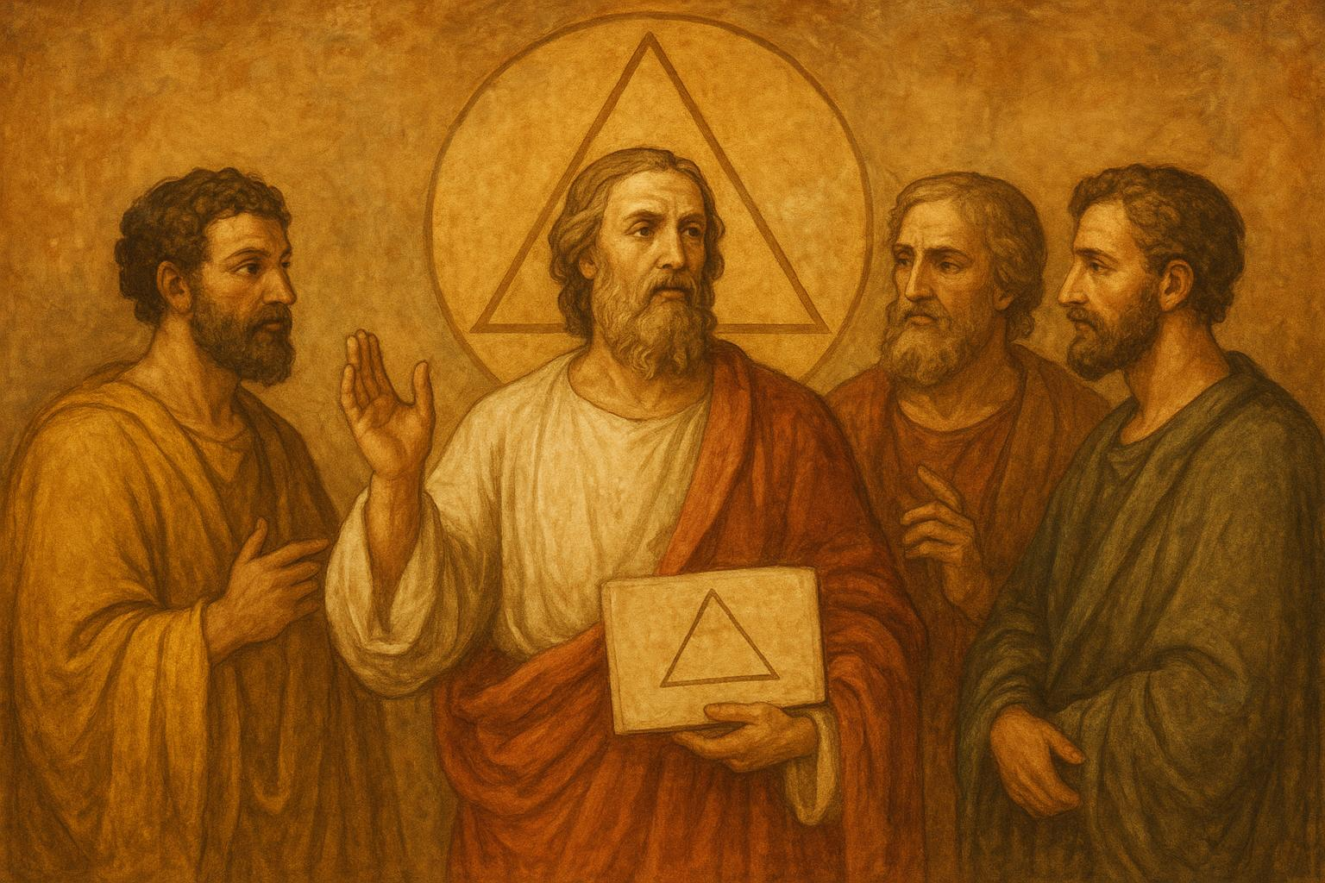
The Pythagoreans also believed in the transmigration of the soul, meaning that the soul continues to exist after death and passes into another body.
The school gained great influence not only in philosophy but also in the political life of the time.
ℝ
α²+b²=c²

Slide 11
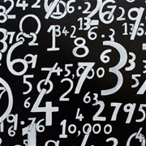
“Everything is Number”
The main philosophical idea of Pythagoras was that “everything is number.” The Pythagoreans believed that the entire universe operates according to mathematical laws.
They observed that:
musical sounds are connected to numerical ratios,
geometry is based on numbers,
the movements of celestial bodies show order and symmetry.
ℝ
α²+b²=c²

Slide 12

Thus, they concluded that mathematics is the foundation of nature and reality.
This idea later influenced all of science and philosophy.
ℝ
α²+b²=c²

Slide 13

The Pythagorean Theorem
The most important mathematical result associated with Pythagoras is the Pythagorean Theorem, and it is unknown whether he himself created it or one of his students, who attributed everything to him.
The mathematical formula is: α² + b² = c²
α²+b²=c²
ℝ

Slide 14
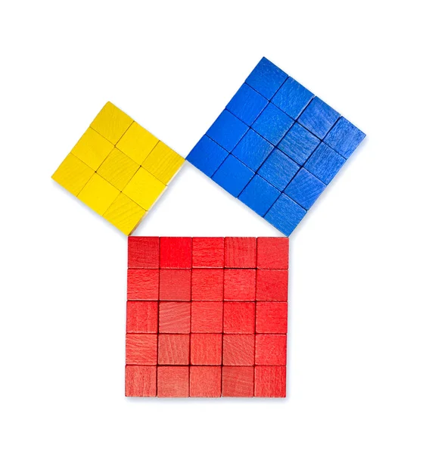
The theorem states that:
“In every right triangle, the sum of the squares of the two shorter sides is equal to the square of the hypotenuse.”
α²+b²=c²
ℝ

Slide 15
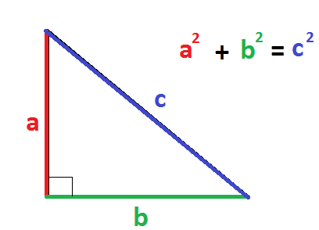
The Pythagorean Theorem is still used today:
in architecture,
in engineering,
in physics,
in astronomy,
in computers and cartography.
α²+b²=c²
ℝ

Slide 16

Music and Mathematics
Pythagoras was also greatly interested in music. He discovered that musical sounds are related to simple mathematical ratios.
For example, when one string is half the length of another, it produces a sound one octave higher.
This discovery showed that even music can be explained through mathematics.
ℝ
α²+b²=c²

Slide 17

The Pythagoreans also believed in the “harmony of the spheres,” meaning that the movements of the planets follow a cosmic harmony.
ℝ
α²+b²=c²

Slide 18
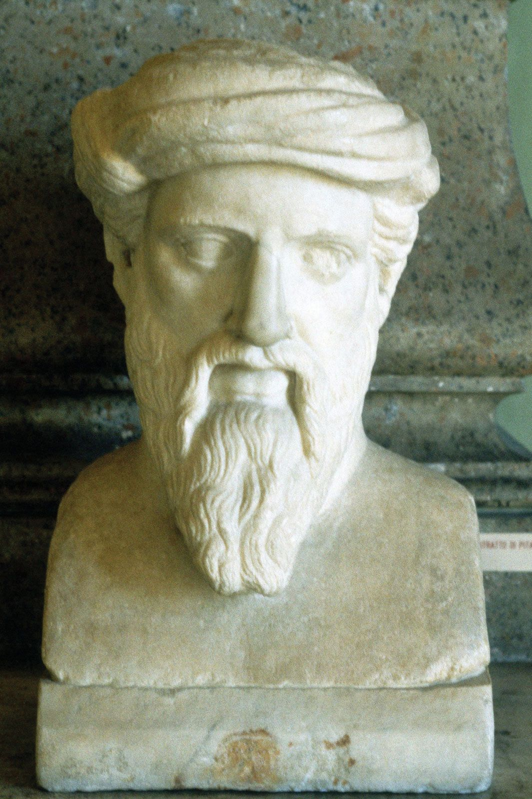
The End of Pythagoras
Pythagoras died around 495 BC.
Despite his death, his ideas continued to influence philosophy, mathematics, and science for many centuries.
ℝ
α²+b²=c²

Slide 19

The Influence of Pythagoras
Pythagoras influenced important philosophers such as:
Plato,
Aristotle,
and later scientists and mathematicians.
The belief that nature can be explained through mathematical laws remains a basic principle of science today.
ℝ
α²+b²=c²

Slide 20
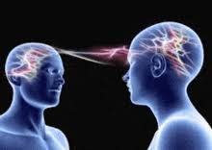
His ideas also influenced:
geometry,
physics,
music theory,
astronomy,
philosophy.
ℝ
α²+b²=c²

Slide 21
o
C
n
n
Let’s see –he, what have we learn?
c
o
l
i
u
s

Slide 22
Pythagoras was one of the greatest personalities of antiquity. Through his ideas and discoveries, he contributed greatly to the development of mathematics and philosophy.
The Pythagorean Theorem is still taught and used throughout the world, while his way of thinking continues to influence science even today.
His belief that the universe is based on numbers and mathematical harmony became a foundation for the later development of human knowledge.
A lot, isn’t it?
CONCLUSION

